Slide 1
Rocket Engine Re-fly
18PD09 - Gowtham Prabhu K A
18PD26 - Praveen S

Slide 2
INTRODUCTION
In today’s world the majority of the space launch cost comes from building the rockets which takes payload to the orbit.
Once it leaves the orbit the rocket is destroyed or left behind, that costs over 40% of the whole cost of the launch.
A fully reusable rocket has never been done before and that really is the fundamental breakthrough needed to revolutionize access to space.
Falcon 9 is a partially reusable two-stage-to-orbit medium-lift launch vehicle designed and manufactured by SpaceX in the United States. The latest version of the first stage can return to Earth and be flown again multiple times.
Notes:
Two stages - 1) rocket dismantle in atmosphere 2) payload launches into its orbit
Aluminum-lithium alloy tanks fuel nine Merlin engines with liquid oxygen and rocket-grade kerosene propellant, generating more than 1.7 million pounds of thrust.
The main engines are cutoff as Falcon 9 nears the edge of Earth’s atmosphere.The total burn time from launch is 162 seconds.
Once beyond Earth’s atmopshere, the pneumatic stage separation system releases the first stage from the second stage. A single Merlin engine fires, propelling stage two into orbit.
The fairing separates from the second stage,exposing the satellite. Merlin engines ignite on the first stage, setting it on a trajectory for the landing site.
The second stage releases the satellite into a predetermined orbit.
The first stage undergoes a flip maneuver using onboard cold gas thrusters. When complete, it is positioned with engines forward.
The first stage grid fins deploy and engines do a temporary burn to slow it down. The grid fins will steer stage one as it enters Earth’s atmosphere.
Landing legs deploy and engines light a final time to land the first stage safely on a designated landing platform.

Slide 3
APPROACH AND MODELLING

Slide 4
Objective :
to build a virtual rocket and address a challenging problem - rocket recycling, by safely landing the rocket with minimal damage through reinforcement learning.
The rocket is simplified into a rigid body on a 2D plane. Lets considered the basic cylinder dynamics model and assumed the air resistance is proportional to the velocity.
The basic parameters of the Starship SN10 belly flop maneuver will be followed.

Slide 5
A thrust-vectoring engine is installed at the bottom of the rocket. This engine provides adjustable thrust values with different directions. An angular velocity constraint will be added to the nozzle.
With the above basic settings, the action space is defined as a collection of the discrete control signals for the engine, including the thrust acceleration and the angular velocity of the nozzle.
The state-space consists of the rocket position, speed, angle, angle velocity, nozzle angle, and the simulation time.

Slide 6
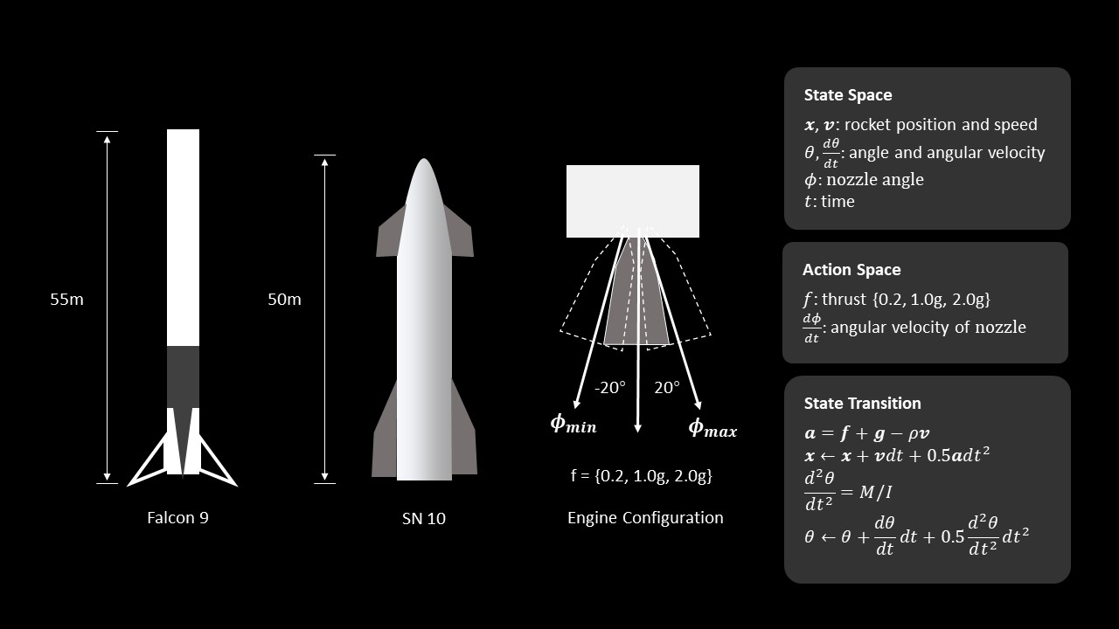

Slide 7
Environment | 2-D plane
Agent | Rocket
State Space | Rocket position, speed, angle, angular velocity, nozzle angle at time t
Action Space | Thrust and the angular velocity of the nozzle
State Transition | Displacement and the angular displacement
Reward | The angle of the rocket body and the distance between the rocket and the predefined target point - the closer they are, the larger reward will be assigned.
Goal State | Successful landing at the specified target point
Model | Actor-critic

Slide 8
REFERENCE
Addressing the Task of Rocket Recycling with Deep Reinforcement Learning
ICIT 2018: Proceedings of the 6th International Conference on Information Technology:
IoT and Smart City December 2018 Pages 284–290
https://dl.acm.org/doi/10.1145/3301551.3301552

Slide 9
Thank You

